Slide 1
Stay Ahead of Delays:
A Consumer-Centric Flight Prediction Model
Team 6: Uriel Choi, Zachary Held, Francisco Moguel, Vivian Shen, Albert Zhang
Notes:
Uriel

Slide 2

Problem + Purpose
On average, 8,000 flights are delayed each day in the US
Billions of passenger dollars are lost annually
Missed connections, rebooking
Food & accommodation
By helping passengers predict the probability of their flight delay, we aim to help alleviate travel stress, disruptions, and costs.
Notes:
Uriel

Slide 3



Research
What is a delay?
Customer impact
Airline impact
USDOT and FAA 15-minute threshold
15 minutes is within acceptable range for OPSNET recording.¹
Average delay time for the satisfied customers is 12 minutes.²
Consumer welfare cost due to delays of $4 Billion annually.³
Average cost of $1.56 per minute delay per person.³
Delays result in increased negative emotions such as anger and worry.⁴
Delays lead consumers to shift to airlines with better punctuality
Increase of 10% delay results in 2.56% decrease in demand.³
Airlines savings of $300,000 to $600,000 per hub per year by using analytics to predict delays.⁵
Notes:
Zac

Slide 4
Original Dataset
Rows: 29 Million Flights from 2019-2023
Columns: 32 variables
Categorical
Origin, Destination, Airline, etc.
Numerical
Elapsed time, air time, etc.
Indicators
Reason of delay, cancellation
With a wide range of variables, it is important to find relationships between them to achieve the desired predictions in a more accurate and efficient manner, while also removing any leakages.
Notes:
Uriel

Slide 5
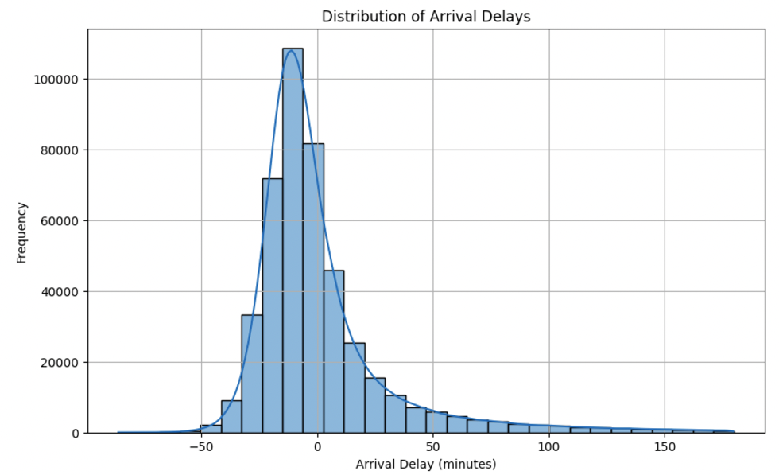
Distribution of Arrival Delays
Notes:
Uriel

Slide 6
Next steps
Given this, we started analyzing patterns using visualizations of the data and computing ratios, correlation analysis, and identifying direct leakages so we could clean the dataset. In addition, we conducted research to determine which approach to take.
Notes:
Francisco

Slide 7
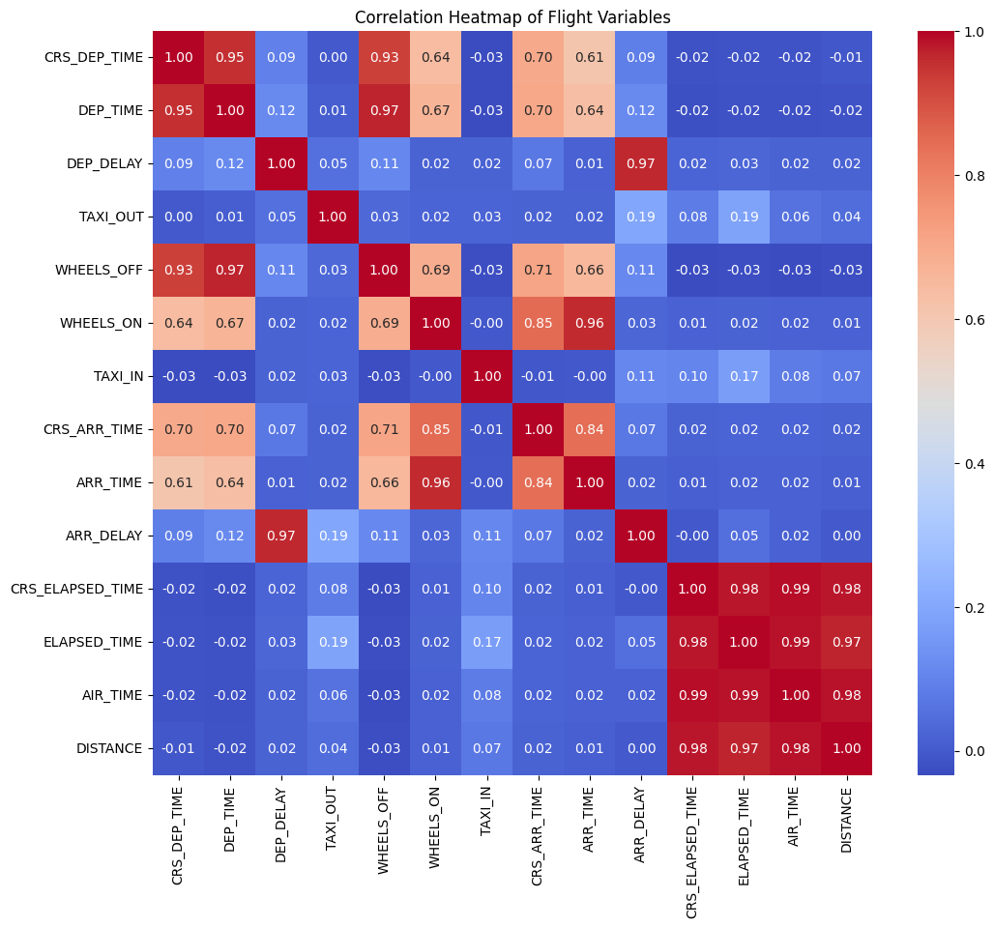
Example of leakage identification:
Notes:
Francisco

Slide 8
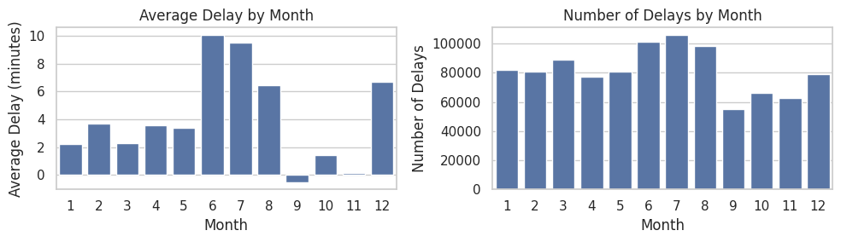
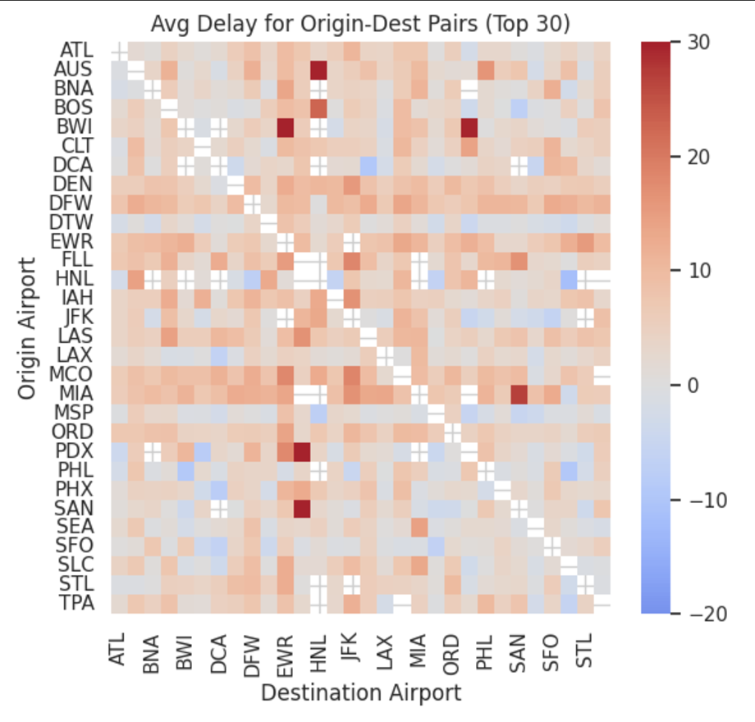
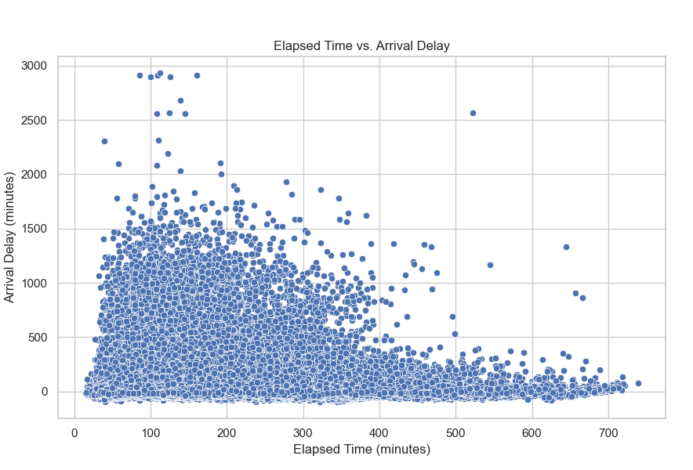
Data Processing
Bar Graphs
Which variables have better correlation to the target?
Heatmap
Which variables are correlated?
Studies
Historical data for context
Notes:
Francisco

Slide 9
Feature Engineering
Month
Routes
-1 to 1
-1 to 1
Indicator for Monthly delays
Create a indicator for prone routes
Notes:
Francisco

Slide 10
Data Cleaning
Airports
Date
Remove leakages
Transform target
Keep only the 30 biggest one ensuring distribution
Separate to day of the week and month and remove 2020
Reason of delay is removed as that is not known and also removed delays by security
To 0-1 and 15+ delays (2 files)
Notes:
Francisco

Slide 11
New Final Datasets
Variables
Target Variable
Airline (String & Categorical)
Origin (String & Categorical)
Destination (String & Categorical)
CRS Elapsed Time (Float & Numerical)
Air Time (Float & Numerical)
Distance (Float & Numerical)
Monthly Indicator (Float & Numerical)
Route Indicator (Float & Numerical)
Month (Int & Numerical)
Day of the Week as 0-6 (Int)
Departure Hour (Int)
Number of rows: 823,633
Dataset 1: Arr Delay as a 0-1 Indicator on a 15 minute threshold
Dataset 2: Arr Delay as 0 for no delay and the actual number as a float for delay time
Notes:
Vivian

Slide 12
Comparison of Model Performance
Rank | Model | MSE (0-1) | MSE (15+ reclassified as 0-1) | MSE (15+)
1 | Boosting | 0.132 | 0.29 | 1304
2 | Neural Net | 0.137 | 0.25 | 1312
3 | Linear Reg. | 0.137 | 0.35 | 1337
4 | Random Forest | 0.141 | 0.31 | 1323
5 | KNN | 0.188 | 0.35 | 1682
Notes:
Albert

Slide 13
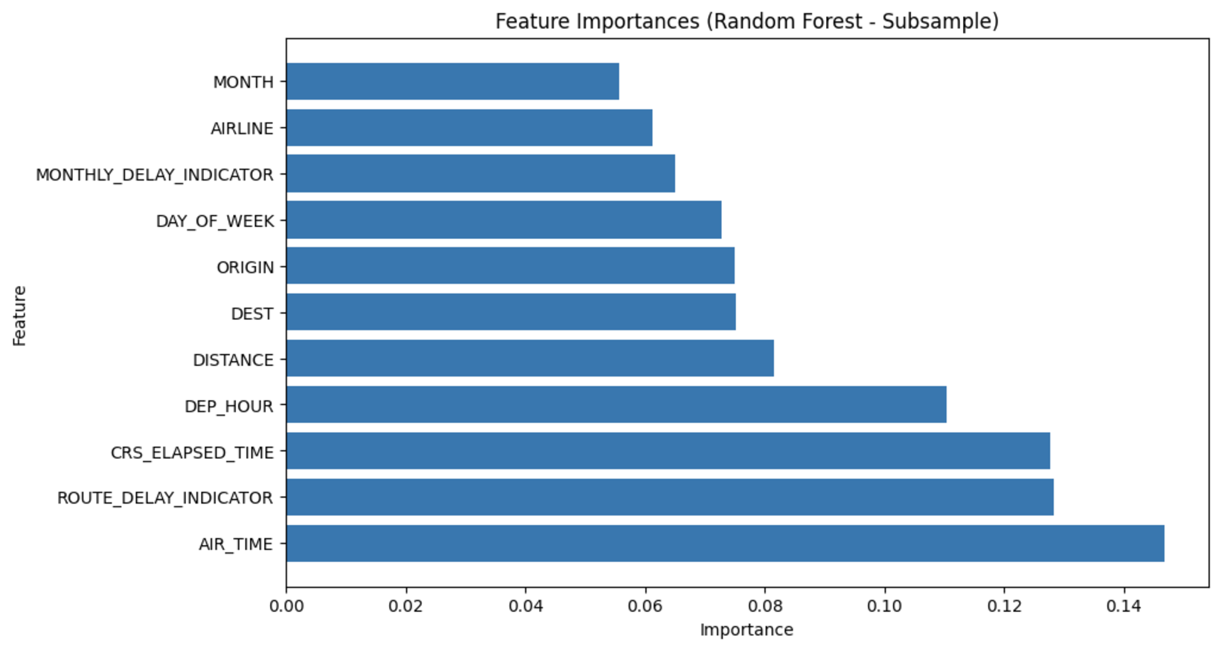
Feature Importances - RF
Notes:
Francisco

Slide 14
Boosting
Can capture complex, non-linear relationships
Focuses on hard to predict cases
Can handle categorical variables
Implementation:
Used LightGBM for native categorical feature
Tuned hyperparameters by testing 10 different configurations
Performed cross validation to confirm predictability of MSE
Notes:
Albert

Slide 15
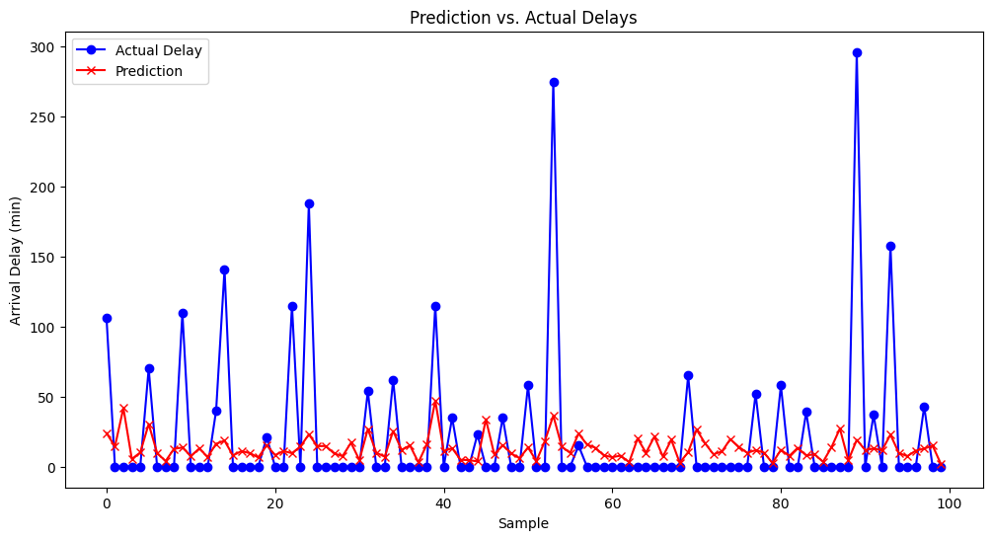
Boosting (15+)
Notes:
Albert

Slide 16
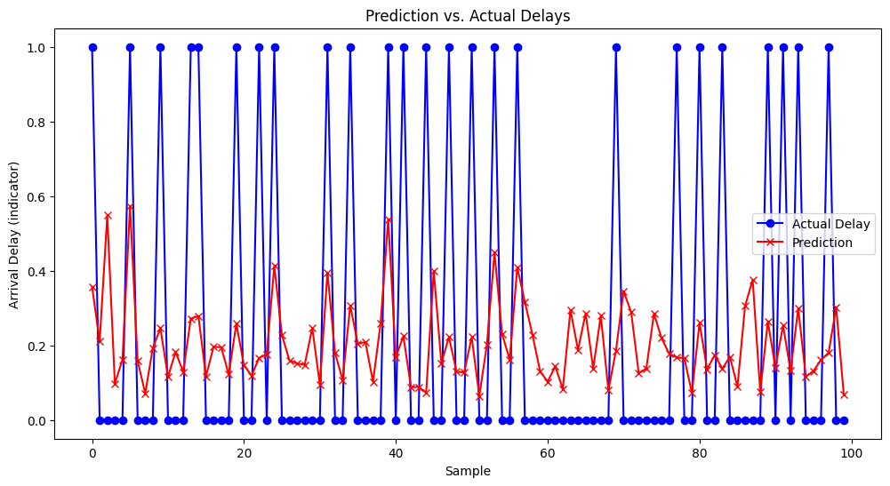
Boosting (0-1)
Notes:
Albert

Slide 17
Challenges and mitigation strategies
Problem | Mitigation Approach
Large dataset computationally demanding | Reduced dataset size by shrinking it and reduce tree depth and NN number of layers
Categorical variables couldn’t be included in many models | One-hot encoded airline data and dropped other categorical variables, Switched to the LightGBM library
Used actual elapsed time (leaky variables) | Switched to CRM (estimated elapsed time) to avoid data leakage.
Difficult to predict higher delays | Ran models on 0/1 predictors - still very difficult to predict long delays
Difficult to choose best parameters for neural nets and random forests | Perform Grid Search across a few parameter combinations
Notes:
Zac

Slide 18
Conclusion
Key Takeaways
Future Improvements
Boosting models performed best, achieving the lowest MSE
Feature engineering and data cleaning ensure more reliable and accurate results.
Predicting long delays remains challenging due to limited data variability
Incorporate broader contextual data, such as regional holidays and weather patterns
Create a separate model specifically for predicting long delays
Need additional data from airlines that explain delay (inbound flight data, maintenance, airport construction/closures, etc.)
Notes:
Vivian

Slide 19
Sources
Federal Aviation Administration, "Types of Delay," ASPM Help, accessed December 1, 2024, https://aspm.faa.gov/aspmhelp/index/Types_of_Delay.html.
Harish Reddy Patlolla, "US Airline Passenger Satisfaction," MWSUG 2019 RF-079, Oklahoma State University, accessed December 1, 2024, https://www.mwsug.org/proceedings/2019/RF/MWSUG-2019-RF-079.pdf.
Philip G. Gayle and Jules O. Yimga, “How Much Do Consumers Really Value Air Travel On-Time Performance, and to What Extent Are Airlines Motivated to Improve Their On-Time Performance?” Economics of Transportation, forthcoming, draft dated December 1, 2017, https://www.k-state.edu/economics/pdfs/websitefiles/gayle/Manuscript_Gayle_Yimga_website.pdf.
John Forrester, Jianfeng Lu, and Lingyan Zhang, "Sustainable Aviation Fuel: Forecasting Perspectives," Transport Policy 106 (2021): 1-14, accessed December 1, 2024, https://www.sciencedirect.com/science/article/abs/pii/S1447677021000358.
"4 Ways Traditional Weather Forecasts Negatively Impact Airlines & Airports," Tomorrow.io Blog, accessed December 1, 2024, https://www.tomorrow.io/blog/4-ways-traditional-weather-forecasts-negatively-impact-airlines-airports/.
Airlines.org, “U.S. Passenger Carrier Delay Costs,” Airlines for America, accessed December 1, 2024, https://www.airlines.org/dataset/u-s-passenger-carrier-delay-costs/
FlightAware, “Live flight delay and cancellation statistics,” accessed December 1, 2024, https://www.flightaware.com/live/cancelled/
Notes:
Uriel

Slide 20
Thank you!
Questions?
Notes:
Uriel

